Slide 1

Analyse and predict average temperature from the agri-food sector, using data from the FAO and IPCC, to understand climate impacts and develop sustainable strategies for stakeholders including policymakers and agricultural businesses.

Slide 2
Table of Contents
Project Objectives
2
Introduction to Dataset
3
Tools and Technologies
4
Cleaning the data
5
EDA
6
Models
7
Models Comparison and Evaluation
8
Conclusion

Slide 3
Project Objectives
Educational Objective
Apply regression analysis techniques in Python to a real-world dataset.
Understand the practical use of regression for forecasting climate-related variables, specifically average temperature in the agri-food sector.
Technical Objective
Analyse and model the relationship between agricultural emissions and temperature.
Use regression models to forecast average temperature based on multiple agricultural and environmental features.
Collaborative Objective
Work effectively as a team using collaborative tools such as GitHub for version control and Trello for task management.
Practice agile project management and collaborative coding workflows.
Outcome Objective
Deliver a well-documented Jupyter Notebook with EDA, model training, evaluation, and recommendations.
Present findings in a clear and engaging slide deck using Google Slides or Canva.

Slide 4
Introduction to Dataset
What does the Dataset tells us about the Project?
This project aims to analyse and forecast temperature trends within the agri-food sector by leveraging data from the FAO and IPCC.
The goal is to assess the impacts of climate change and support the development of sustainable strategies for key stakeholders, including policymakers and agricultural enterprises.
The dataset provides a comprehensive view of agricultural and environmental indicators across 235 countries from 1990 to 2020.
It includes 29 features related to agricultural practices, emissions, population demographics, and climate metrics.
The primary focus is on understanding how various agricultural activities contribute to total emissions and how these relate to changes in average temperature.
This data enables us to explore patterns, identify high-emission contributors, and build regression models to forecast temperature trends.
Ultimately, the dataset supports the goal of informing sustainable agricultural strategies and climate policy decisions.

Slide 5
Tools and Technologies
GitHub: Version control and collaboration (Github Workspace)
Trello: Task management (Group Trello Board)
Anaconda/VSCode: Development environment, importing necessary packages, machine learning tools
Slides: Presentation visuals

Slide 6
Cleaning the data
There were 11 out of the 31 columns that had missing data. This was cleaned and replaced with zero in the dataset.
The year and area columns were also changed into integer data types to allow it to be used within the modelling process later on.
We checked for duplicates and found none.
We standardised the column names and removed the space and replaced with an underscore.
Overall, there were not too many data issues found in the dataset.

Slide 7
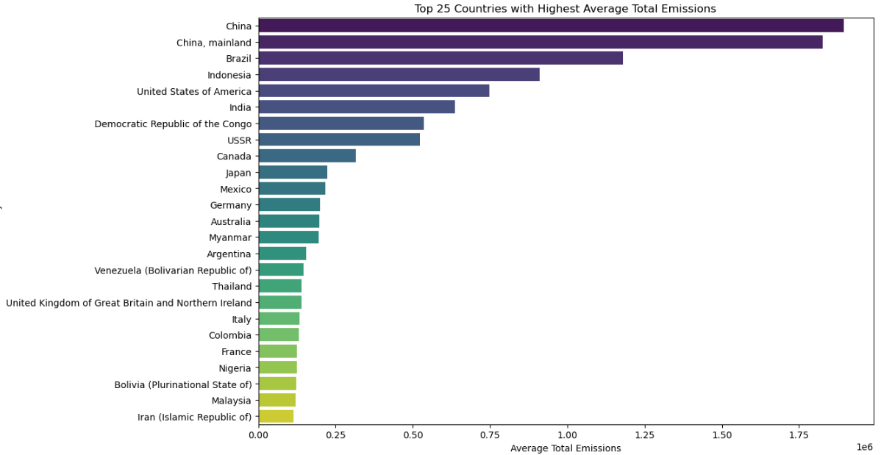
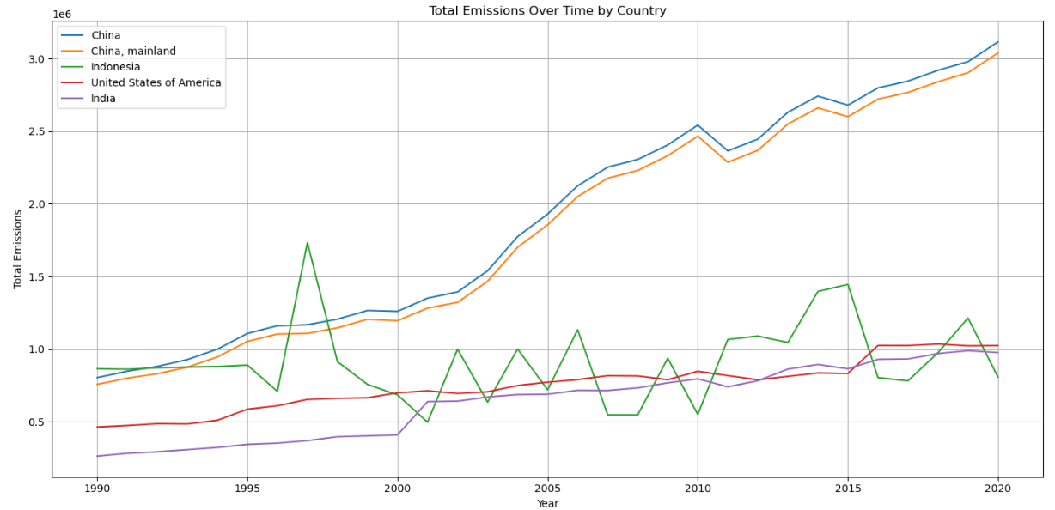
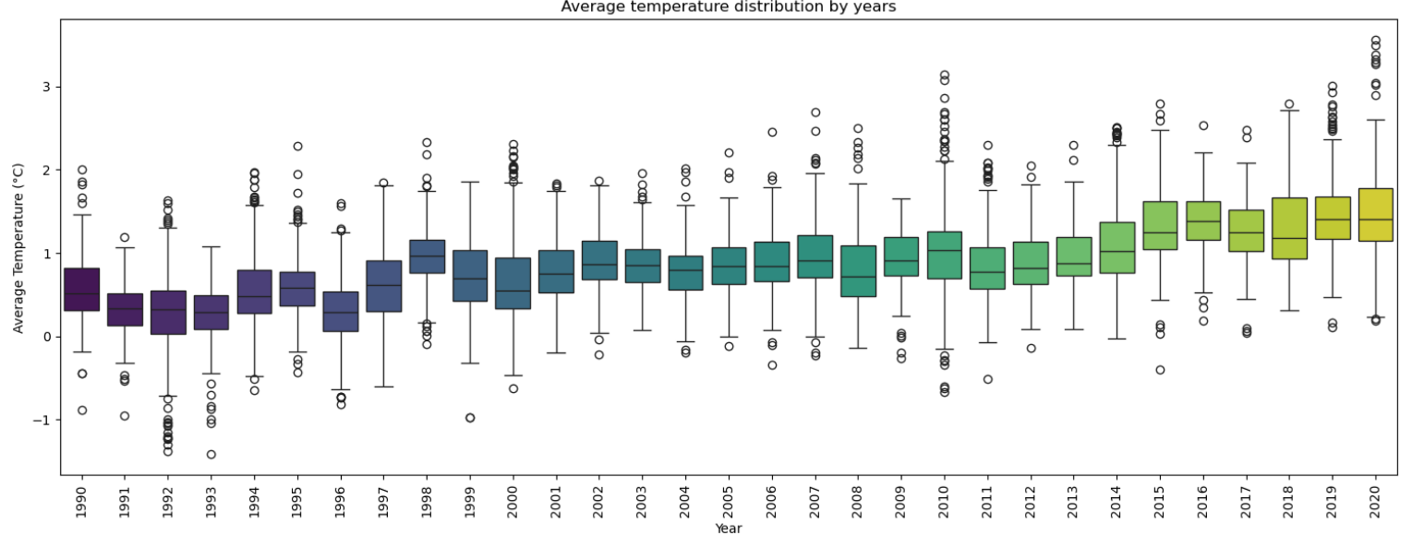
EDA Analysis
We extracted the top 25 countries with the highest average total emissions. The top 5 countries were China & China Mainland, Brazil, Indonesia and USA.
To better understand the distribution of the emissions, we then did a histoplot of the total emissions to understand within which range they fell within the dataset and detect any outliers.
This prompted us to delve deeper into the data and plot the emissions over time for the top 5 countries to determine if there were any significant variations over time.
I box plot was used to show the average temperature change over time. The average temperature shows a gradual increase over the 30-year period. This suggests a warming trend, consistent with global climate change patterns.
The IQR and presence of outliers indicate fluctuations in temperature. Some years have higher variability, which could be due to extreme weather events or other anomalies.
Outliers highlight years with extreme temperatures. Identifying these years can help understand specific events that caused significant deviations from the norm.

Slide 8
Models Overview
Approach:
Train-test split applied consistently across models.
Models trained: Lasso, Linear Regression, Random Forest, Decision Tree.
Evaluation metrics: R² Score, MSE, RMSE, Residuals.
Models
Linear Regression
Random Forest Regression
Decision Tress Regression
Lasso Regression

Slide 9
Models Performance : Linear Regression
What it does:
A Linear Regression model is one of the simplest and most widely used algorithms in machine learning and statistics. It helps you understand the relationship between a dependent variable (target) and one or more independent variables (features).
Linear regression tries to fit a straight line (or hyperplane in multiple dimensions) through the data that best predicts the target variable.
When to use it:
When you want to predict a continuous value (e.g., CO₂ emissions, house prices).
When you want to understand the influence of each feature on the target.
What is portrays:
Coefficients: Show how much each feature contributes to the prediction.
Intercept: The baseline prediction when all features are zero.
Metrics:
R² Score: How well the model explains the variance in the data.
RMSE: The average prediction error.

Slide 10
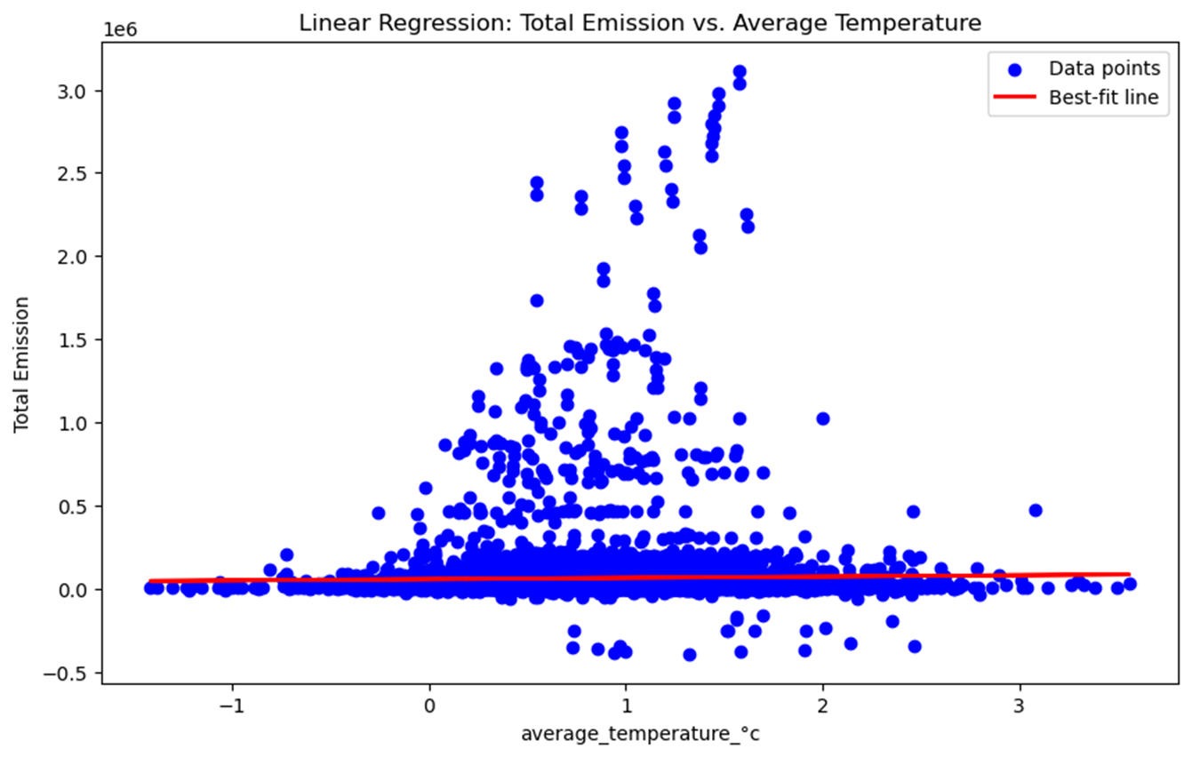
Models Performance : Linear Regression
Model Performance:
R² Score: 0.9932 - the model explains 99.32% of the variance in emissions.
RMSE: 21,755 - the average prediction error in the same units as total emission.
What You See:
Blue dots: Actual data points (observations).
Red line: The best-fit line learned by the Linear Regression model.
The model tries to minimize the distance between the line and the actual data points.

Slide 11
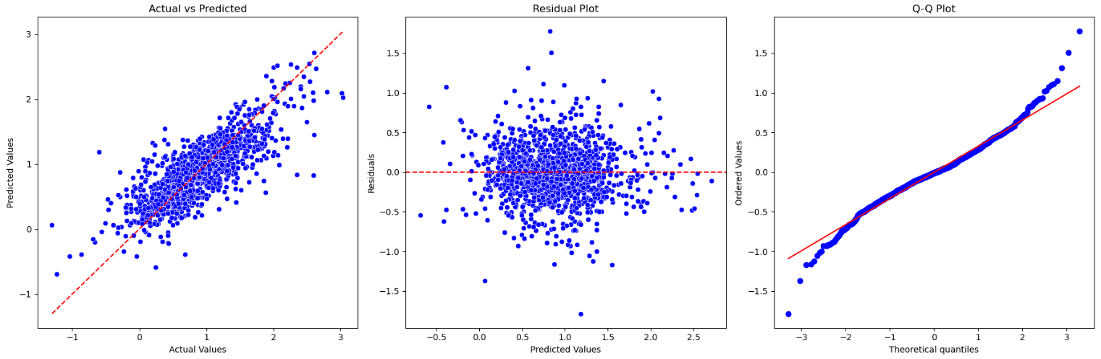
Models Performance : Random Forest Model
Model Performance Metrics
Mean Absolute Error (MAE): 0.2455
Root Mean Squared Error (RMSE): 0.3334
R² (Coefficient of Determination): 0.6374
Interpretation of Results
MAE: The average absolute error between the predicted and actual values is 0.2455. This indicates that, on average, the model's predictions are off by about 0.2455°C.
RMSE: The RMSE value of 0.3334 suggests that the model's predictions deviate from the actual values by approximately 0.3334°C on average. RMSE is more sensitive to larger errors compared to MAE.
R²: The R² value of 0.6374 indicates that approximately 63.74% of the variance in the average temperature can be explained by the model. This suggests a moderate level of predictive power.
Visual Analysis
Actual vs Predicted Values: The scatter plot shows the relationship between the actual and predicted values. The red dashed line represents the ideal scenario where predictions perfectly match the actual values. The closer the points are to this line, the better the model's performance.
Residual Plot: This plot displays the residuals (errors) against the predicted values. Ideally, residuals should be randomly distributed around zero, indicating no systematic errors.
Q-Q Plot: The Q-Q plot compares the distribution of residuals to a normal distribution. If the residuals follow a normal distribution, the points should lie along the red line.
Overall, the model demonstrates a reasonable level of accuracy in predicting average temperatures based on the selected features.

Slide 12
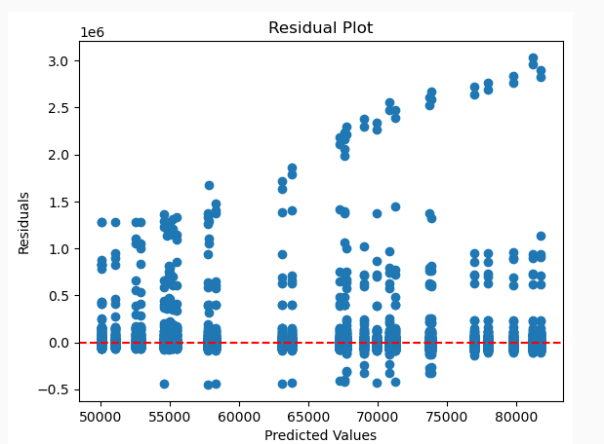
Models Performance : Decision Tree
Interpretation and Key Insights from Decision Tree Regression Analysis:
Model Fit and Residuals
Observed Values: These are the actual CO2 emissions recorded in the dataset.
Predicted Values: These are the values predicted by the Decision Tree Regression model based on the year.
Residuals: The differences between the observed values and the predicted values. In this case, the residuals are zero for the first few years, indicating that the model perfectly predicted the values for those years.
Residual Plot Analysis
The residual plot shows the residuals (errors) on the y-axis and the predicted values on the x-axis.
Horizontal Line at Zero: The red dashed line at zero represents where the residuals would be if the model's predictions were perfect.
Scatter of Residuals: The points scattered around the horizontal line indicate the differences between the observed and predicted values. Ideally, these points should be randomly distributed around the zero line, indicating no systematic error in the model.
This plot shows the differences between the observed and predicted values

Slide 13
Models Performance : Decision Tree
Key Insights
Perfect Predictions for Initial Years: The model perfectly predicted the CO2 emissions for the initial years (1990-1994), as indicated by the zero residuals.
Model Performance: The Decision Tree Regression model seems to fit the data well for the initial years but may need further evaluation for later years.
Potential Overfitting: Decision Tree models can sometimes overfit the data, capturing noise rather than the underlying trend. This can be checked by evaluating the model on a separate test dataset.
Further Analysis: To improve the model, consider using more sophisticated techniques like Random Forests or Gradient Boosting, which can provide better generalization.
Recommendations
Model Validation: Validate the model using cross-validation techniques to ensure it generalizes well to unseen data.
Feature Engineering: Explore additional features that might influence CO2 emissions, such as economic indicators, population growth, or technological advancements.
Model Comparison: Compare the performance of the Decision Tree model with other regression models to identify the best fit for the data.
This plot shows the differences between the observed and predicted values

Slide 14
Models Performance : Lasso Regression
What it does:
Lasso (Least Absolute Shrinkage and Selection Operator) is a linear regression technique that adds L1 regularization to the loss function.
It penalizes the absolute values of coefficients, which:
Helps prevent overfitting.
Can shrink some coefficients to exactly zero, effectively performing automatic feature selection.
Why use Lasso:
Ideal when working with many features or high-dimensional data.
Improves model interpretability by reducing complexity.
Useful in the presence of multicollinearity (when predictors are highly correlated).
Helps identify the most influential variables in predicting the target.
Tuning the Alpha Parameter:
alpha controls the strength of regularization:
Higher alpha → stronger penalty → more coefficients shrink to zero.
Lower alpha → less penalty → model behaves more like standard linear regression.
Use cross-validation (e.g., LassoCV) to find the optimal alpha that balances bias and variance.
Key Takeaway: Lasso is not just a regression model—it's a powerful tool for simplifying models, improving generalization, and uncovering the most relevant predictors in your dataset.

Slide 15
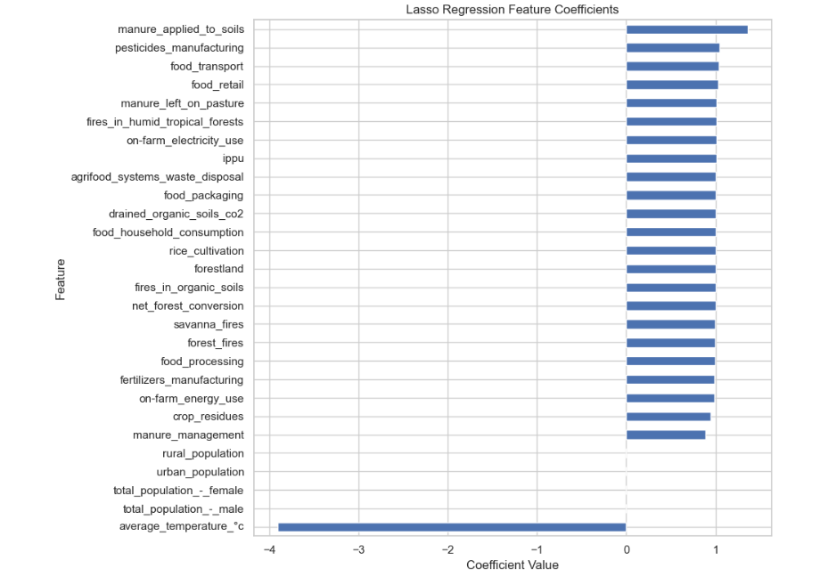
Models Performance : Lasso
Model Performance
R² Score: 0.9999996 — The model explains nearly all the variance in total emissions.
MSE: 25,158 — Very low error, indicating high prediction accuracy.
Insights:
Positive coefficients (bars to the right) indicate features that increase total emissions.
The longer the bar, the stronger the influence.
These features are critical for understanding and managing agricultural emissions.
These features are the most predictive of total CO₂ emissions in the dataset. They represent key leverage points for emission reduction strategies in agriculture and food systems.
This bar chart highlights the non-zero coefficients selected by the Lasso model, showing which features most influence total emissions.

Slide 16
Models Performance : Lasso
Top 5 most influential features from the Lasso Regression model, based on the CO₂ emissions dataset.
Rank | Feature Name | Coefficient | Interpretation
1 | manure_applied_to_soils | 1.364 | This is the most influential factor. An increase in manure applied to soils is strongly associated with higher total emissions. This likely reflects methane and nitrous oxide emissions from soil microbial activity.
2 | pesticides_manufacturing | 1.044 | Emissions from pesticide production contribute significantly to overall emissions, likely due to energy-intensive chemical processes.
3 | food_transport | 1.037 | Transporting food adds to emissions, especially if reliant on fossil fuels. This highlights the carbon footprint of logistics in the food supply chain.
4 | food_retail | 1.025 | Emissions from retail operations (e.g., refrigeration, lighting) are a notable contributor to total emissions.
5 | manure_left_on_pasture | 1.014 | Like manure application, manure left on pasture contributes to emissions through decomposition and gas release.
This table highlights the features with the strongest predictive power for total emissions, based on their coefficient values

Slide 17
Models Performance : Lasso
Why Lasso was a good fit ?
High-Dimensional Dataset
The dataset contains many features related to agricultural activities, emissions sources, and food systems. Lasso is ideal for this because it:
Handles multicollinearity well.
Automatically selects the most relevant features by shrinking others to zero.
2. Feature Selection
Lasso helped identify the top 5 drivers of total emissions:
manure_applied_to_soils
pesticides_manufacturing
food_transport
food_retail
manure_left_on_pasture
This simplifies interpretation and focuses attention on key emission sources.
3. Model Performance
R² Score ≈ 1.0: The model explains nearly all the variance in total emissions.
Low MSE: Indicates accurate predictions.
This suggests that the selected features are highly predictive and that the model generalizes well.
4. Interpretability
The resulting model is sparse and interpretable, which is important for:
Communicating findings to stakeholders.
Designing targeted interventions (e.g., reducing emissions from manure management or transport).
Additional:
Policy Implications: The top features point to specific intervention areas — such as improving manure handling or reducing transport emissions — that could significantly reduce total emissions.
Scalability: The approach can be scaled to other countries or regions using similar datasets.
Model Simplicity: Compared to more complex models (e.g., Random Forests), Lasso offers a transparent and explainable solution.

Slide 18
Models Comparison and Evaluation
Evaluation Metrics Used
R² Score: Measures how well the model explains variance in the target variable.
MSE / RMSE: Indicates average prediction error.
Residual Analysis: Assesses model fit and potential overfitting.
Feature Interpretability: Evaluates how well the model highlights key predictors.
Model Performance and Summary
Model | RMSE | R² | Strengths | Weaknesses | Observations
Linear Regression | RMSE: 27.15 | R²: 0.62 | - High accuracy - Easy to interpret coefficients - Good baseline model | - Slightly less accurate than Lasso - Sensitive to multicollinearity | - Linear Regression provides a good balance between simplicity and performance. - Suitable for initial analysis of data trends.
Decision Tree | Residuals: NA | - | - Perfect fit for early years - Easy to visualize and interpret | - Overfits early data - Poor generalization without pruning | - Decision Tree provides good predictions in the short term but may struggle with accuracy in later years.
Random Forest | RMSE: 0.333 | R²: 0.638 | - Captures non-linear relationships - Robust to outliers - Improved with tuning | - Less interpretable - May require more data and tuning to optimize | - Significant improvement over previous version. - Now performs competitively with linear models and offers flexibility for complex relationships.
Lasso Regression | RMSE: 25.81 | R²: 0.65 | - Excellent accuracy - Performs feature selection - Handles multicollinearity well | - Requires tuning of alpha - May underfit if alpha is too high | - Useful for small datasets and models in both accuracy and interpretability. - Can be used as a baseline model for comparison with other models.

Slide 19
Conclusion
The modelling process effectively identified the most predictive features of agricultural CO₂ emissions using a range of regression techniques. Lasso Regression remained the most accurate and interpretable model, offering strong feature selection capabilities. Linear Regression provided a reliable and transparent baseline. The Random Forest model showed for capturing non-linear relationships when properly optimized. Decision Tree models, while interpretable, showed signs of overfitting and limited generalization.
Key Insights
Emissions are driven by a small subset of impactful features, as highlighted by Lasso.
Residual and visual analyses revealed patterns, outliers, and model behavior over time.
Model performance varied, reinforcing the importance of tuning, validation, and model selection based on project goals.
Strategic Recommendations
Deploy Lasso Regression for predictive modeling and policy simulations.
Use Linear Regression for interpretability and stakeholder engagement.
Consider Random Forest as a flexible, non-linear model—especially with further tuning and feature engineering.
Enrich the dataset with economic, climate, and technological indicators to improve model robustness.
Apply cross-validation and evaluate models on country-specific subsets to ensure generalizability.
Use visual tools (e.g., boxplots, heatmaps, line charts) to communicate findings and support data-driven decision-making.

